Slide 1
Jackets & Hoodies

Slide 2
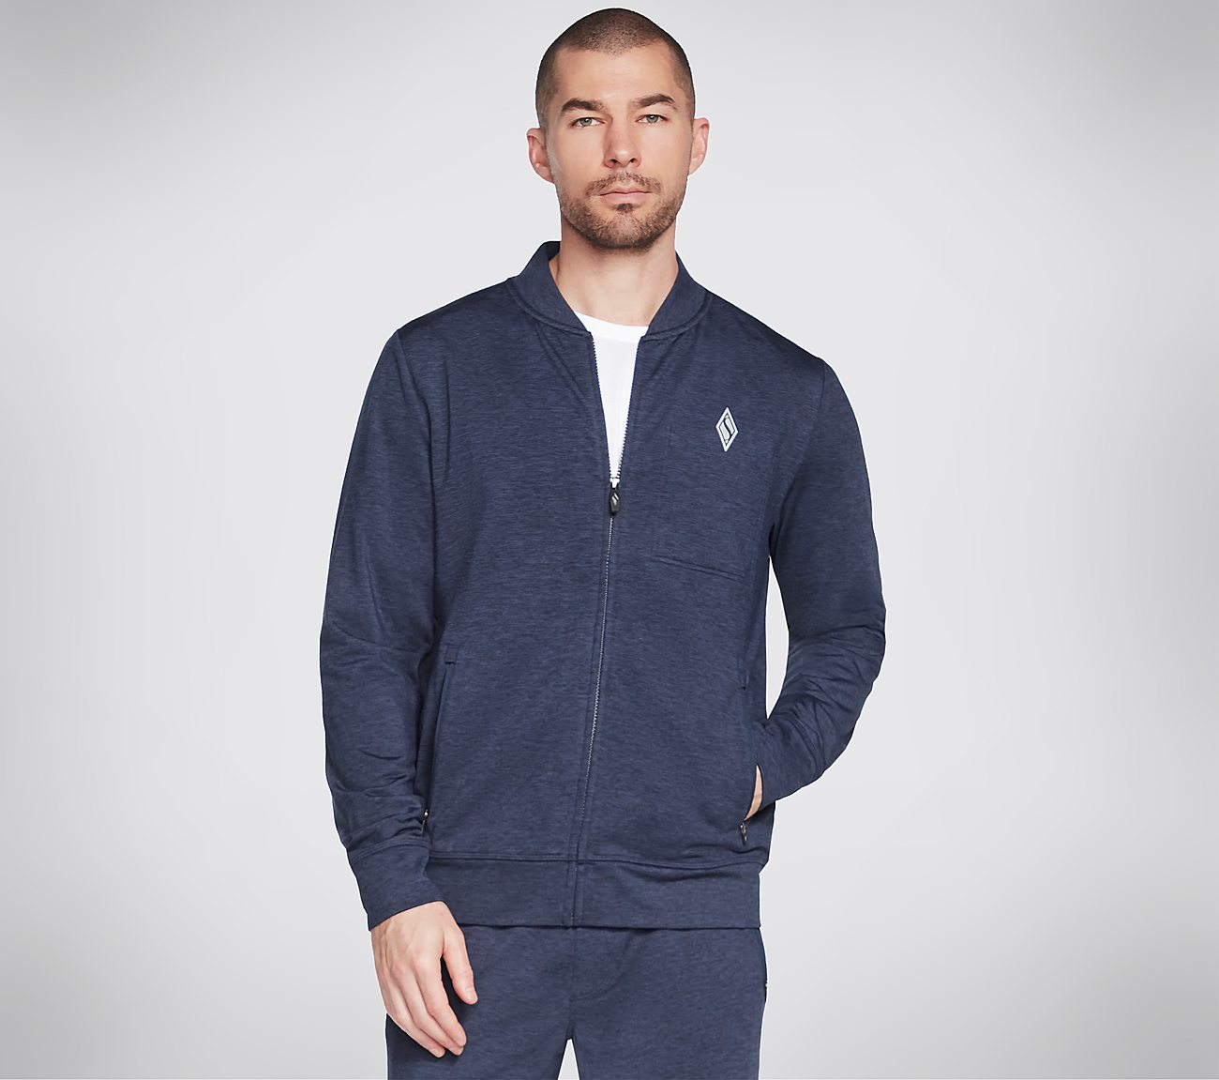
Model no:M3JA212A_NVY
MRP: 4799/-
Design Details :
88% Polyester, 12% Spandex
Full zip jacket with varsity collar
Zipper hand entry pocket
Interior chest pocket
Reflective diamond logo on left chest
Availability :
 | XS | S | M | L | XL | 2XL | 3XL | Total
Size |  | 145 | 284 | 293 | 165 |  |  | 887

Slide 3
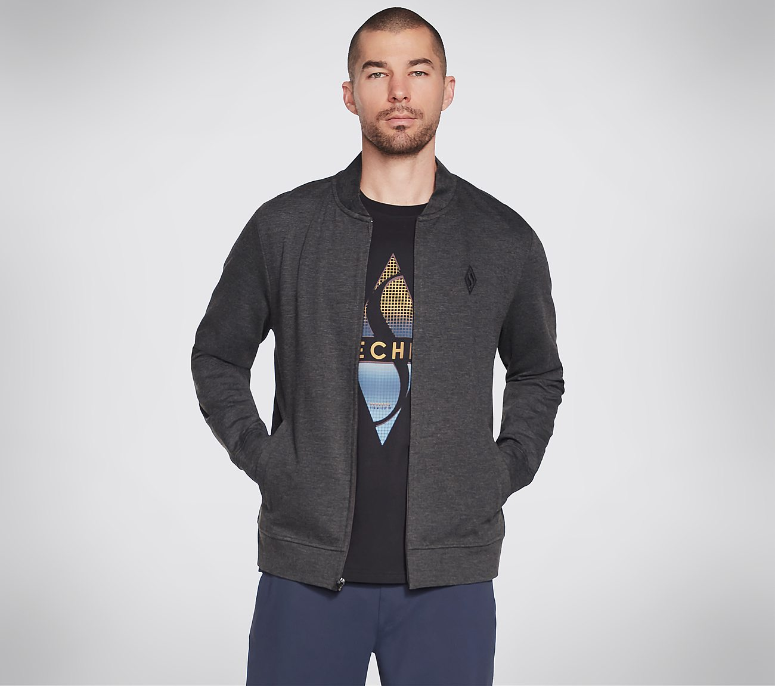
Model no: MJA239-CHAR
MRP: 5999/-
Design Details :
28.0% Nylon,4.0% Spandex,68.0% Rayon
SKECHERS GOKNIT ULTRA JACKET- MOISTURE WICKING MANAGEMENT, COMFORT STRETCH & UPF 40+ FINISH-FULL ZIP MOCK NECK-OPEN HAND WELT POCKETSTWO OPEN HAND WELT POCKETS
Availability :
 | XS | S | M | L | XL | 2XL | 3XL | Total
Size |  | 94 | 170 | 163 | 88 | 1 |  | 516

Slide 4

Model no:MHD63A-BKCC
MRP: 2499/-
Design Details :
100% POLYESTER
Hooded back panel
Flatlock seam
Split kangaroo pocket
Skechers® diamond logo detail
logo on left chest
Availability :
 | XS | S | M | L | XL | 2XL | 3XL | Total
Size |  | 151 | 163 | 199 | 99 | 1 |  | 613

Slide 5

Model no:MHD12A-BLK
MRP: 2299/-
Design Details :
70% Cotton, 30% Polyester Fleece
Hood with adjustable drawcord
2x2 rib cuffs and bottom hem
Kangaroo pocket
Comfort Fit
Skechers heritage logo at chest
Availability :
 | XS | S | M | L | XL | 2XL | 3XL | Total
Size |  | 181 | 347 | 392 | 207 | 57 |  | 1184

Slide 6
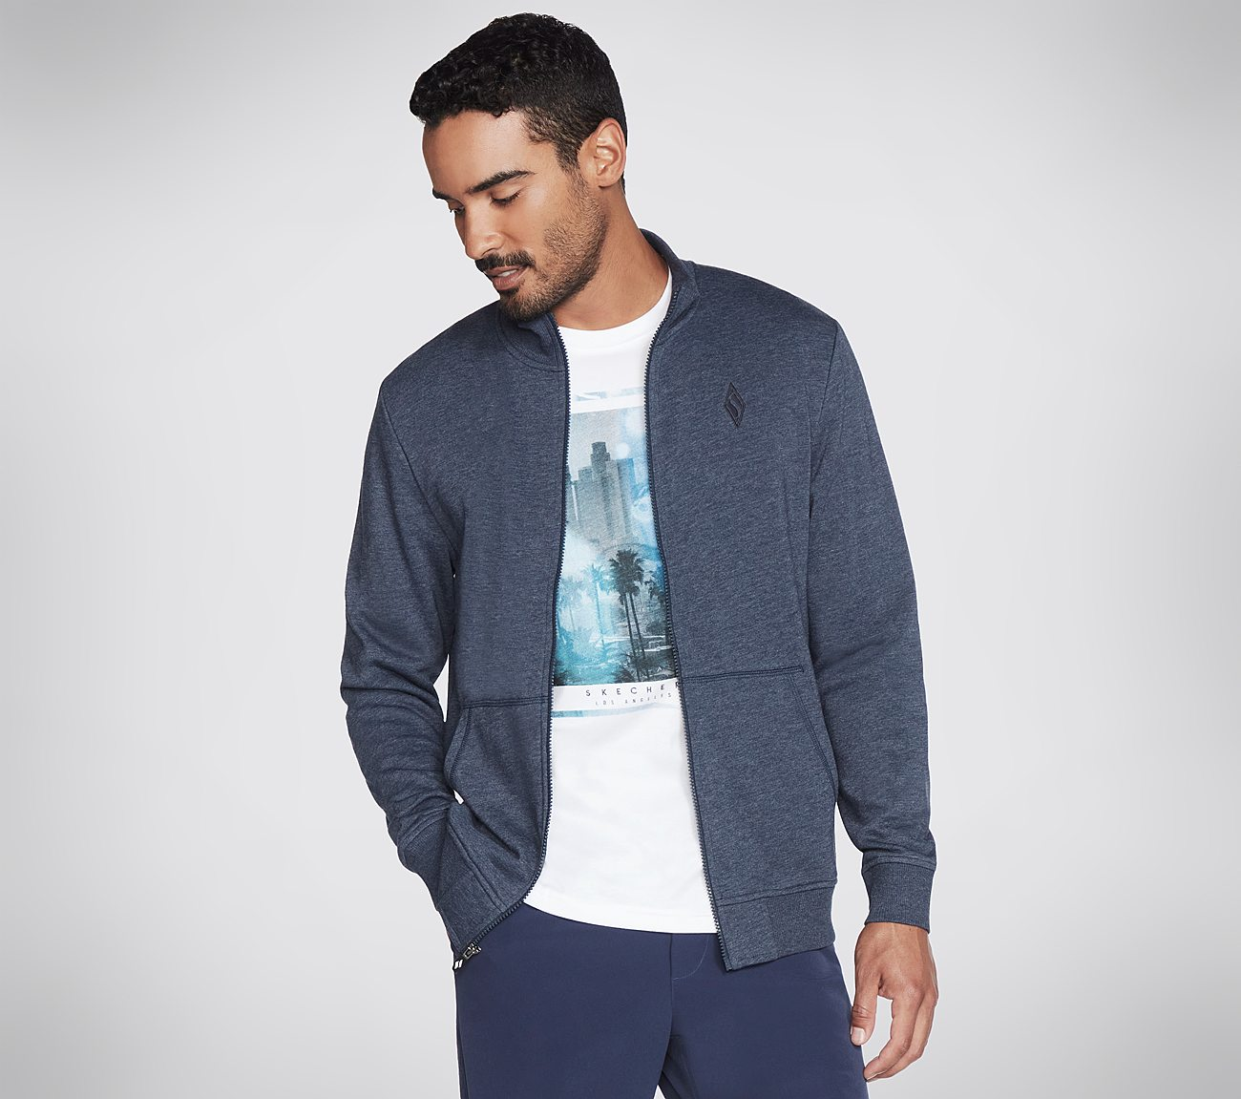
Model no:M3JA195A-NVY
MRP: 3499/-
Design Details :
54% Cotton, 46% Polyester French Terry
Mock neck
Ribbed trim
Split kangaroo pocket
Zip front with Skechers® Diamond silicone zip pull
Skechers® diamond logo detail
Availability :
 | XS | S | M | L | XL | 2XL | 3XL | Total
Size |  | 142 | 385 | 373 | 98 |  |  | 998

Slide 7
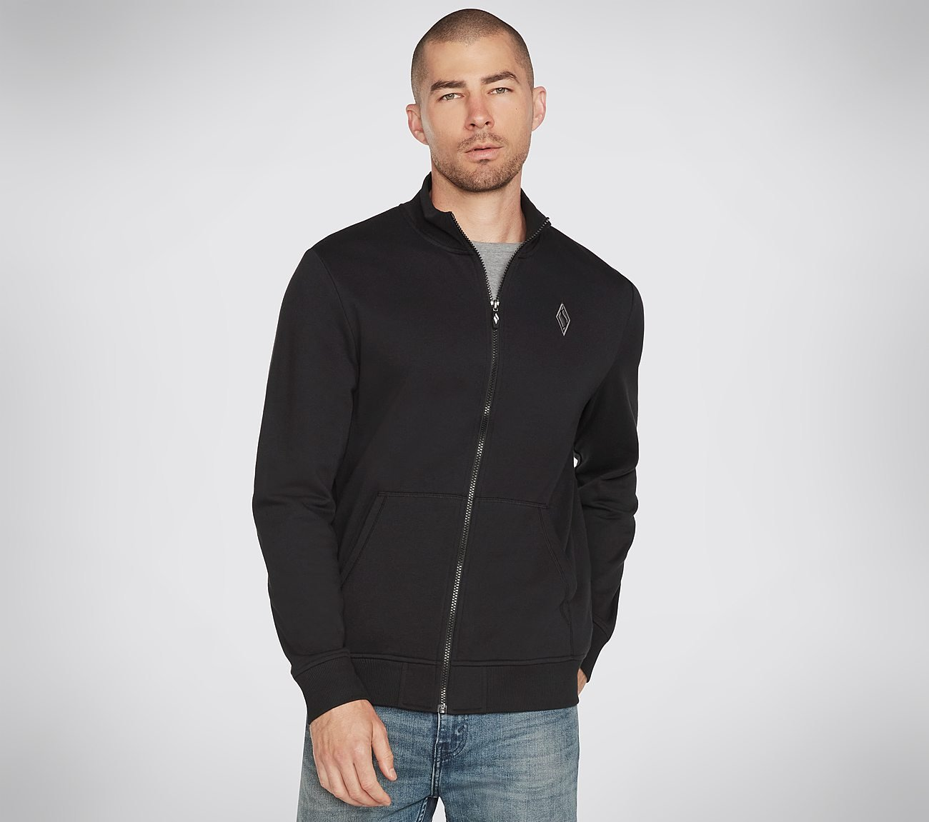
Model no:M3JA195A-BLK
MRP: 3499/-
Design Details :
54% Cotton, 46% Polyester French Terry
Mock neck
Ribbed trim
Split kangaroo pocket
Zip front with Skechers® Diamond silicone zip pull
Skechers® diamond logo detail
Availability :
 | XS | S | M | L | XL | 2XL | 3XL | Total
Size |  | 168 | 344 | 309 | 90 | 43 |  | 954
Notes:
XS S M L XL 2XL 3XL Total Size 168 344 309 90 43 954

Slide 8
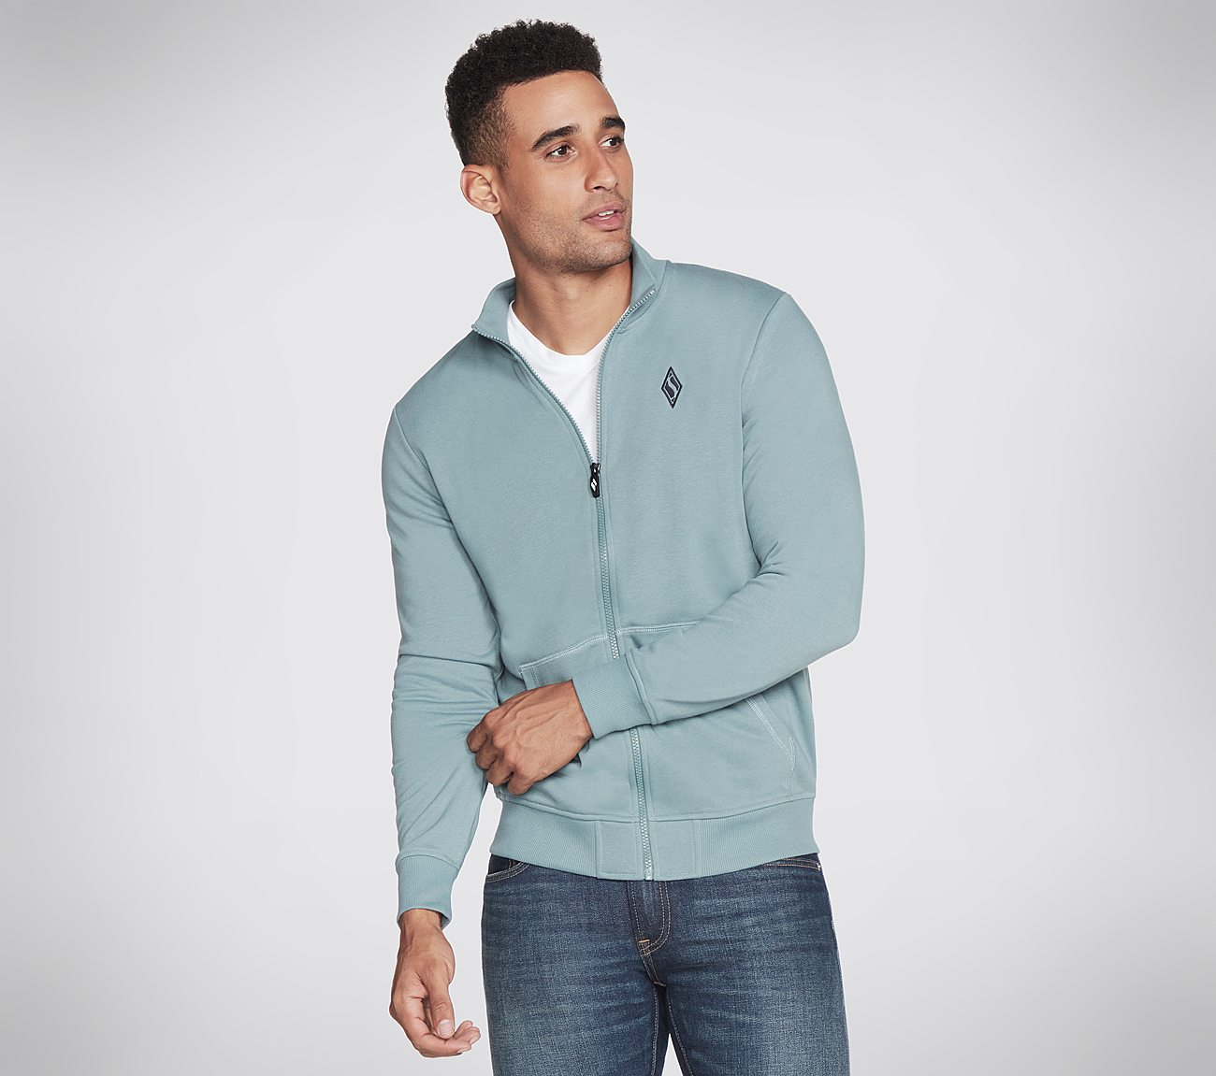
Model no:M3JA195A-TLBL
MRP: 3499/-
Design Details :
54% Cotton, 46% Polyester French Terry
Mock neck
Ribbed trim
Split kangaroo pocket
Zip front with Skechers® Diamond silicone zip pull
Skechers® diamond logo detail
Availability :
 | XS | S | M | L | XL | 2XL | 3XL | Total
Size |  | 100 | 196 | 198 | 107 | 32 |  | 633

Slide 9
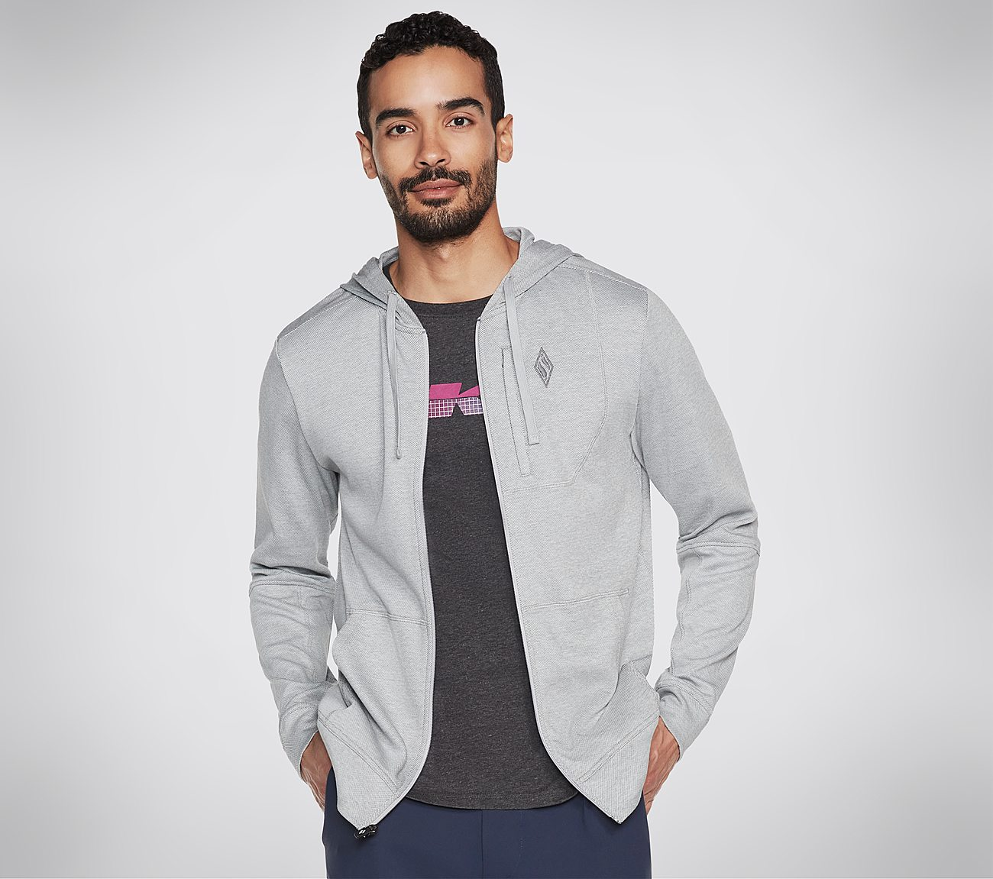
Model no:M3JA154A-LTGY
MRP: 2499/-
Design Details :
68% Cotton, 32% Polyester
Full zip hood with adjustable drawcord
Single welt zipper security chest pocket
Ergonomic silicone diamond logo zipper
Kangaroo pocket
Embroidered Skechers® diamond logo detail
Availability :
 | XS | S | M | L | XL | 2XL | 3XL | Total
Size |  | 99 | 208 | 206 | 79 |  |  | 592

Slide 10
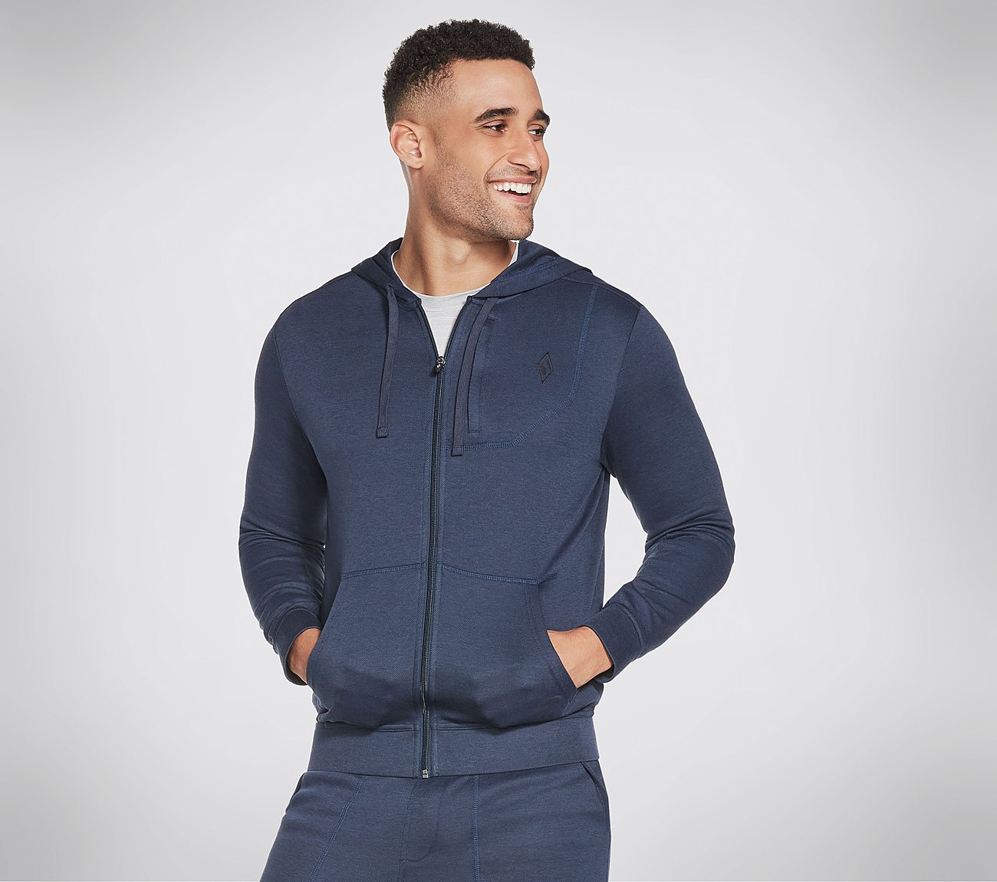
Model no:M3JA154A-NVY
MRP: 2499/-
Design Details :
68% Cotton, 32% Polyester
Full zip hood with adjustable drawcord
Single welt zipper security chest pocket
Ergonomic silicone diamond logo zipper
Kangaroo pocket
Embroidered Skechers® diamond logo detail
Availability :
 | XS | S | M | L | XL | 2XL | 3XL | Total
Size |  | 77 | 155 | 178 | 95 | 42 |  | 547

